Slide 1
DATA ENCAPSULATION

Slide 2
Data encapsulation is the process in which some extra information is added to the data item hence adding some features to it
It is also referred to as Data hiding since it prevents the user from accessing implementation details
It is an Object Oriented Programming concept that binds a group of related functions , properties; and other members are treated as a single unit , for example : Class

Slide 3
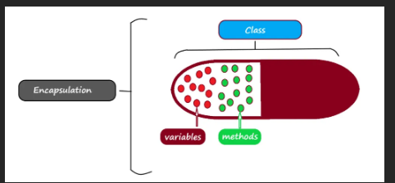
OVERVIEW OF DATA ENCAPSULATION

Slide 4
The idea behind Data Encapsulation is to hide implementation details from users
This is achieved through the state of a Class [private fields] and behaviors of that class [public methods]
Data Encapsulation adds the protocol information to the data so that data transmission takes place in a proper way
Data is encapsulated on the sender’s side and decapsulated on the receiver’s side
The information is added either to the header or the footer of the data
The encapsulation of data at various layers of the implementation models[TCP/IP or OSI] adds both functionalities and features to the data transmission

Slide 5
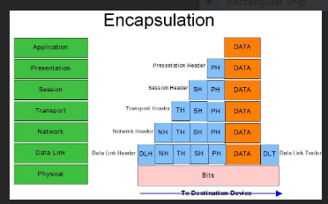
The most important feature being the security and reliability of the data transmission between two nodes in a network
Data is encapsulated on the sender’s side starting from the application layer to the physical layer of the OSI model

Slide 6
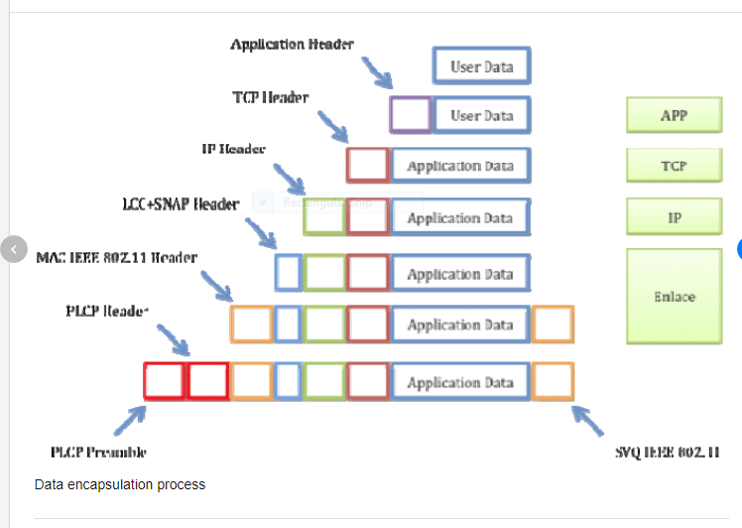
Information added to the header or footer of the data . Each layer takes the encapsulated data from the last layer and adds more information to encapsulate it and some more functionalities with the data

Slide 7
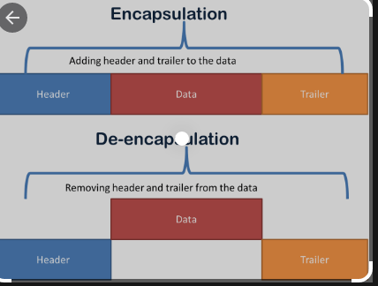

Slide 8
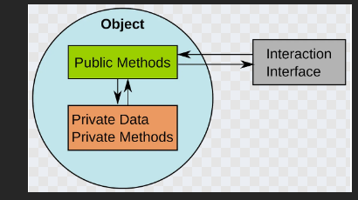
These functionalities may include proper data sequencing , error detection and control , flow and congestion control , routing information and others
Encapsulation guarantees the integrity of the data contained in the Object

Slide 9
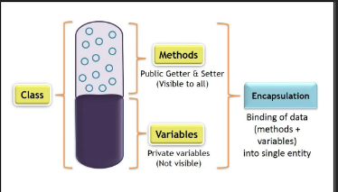

Slide 10
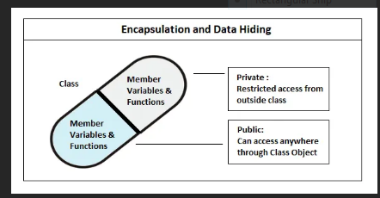

Slide 11
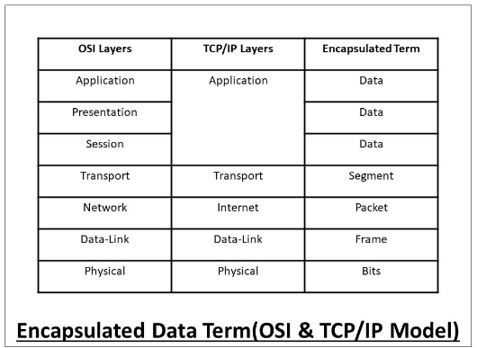

Slide 12
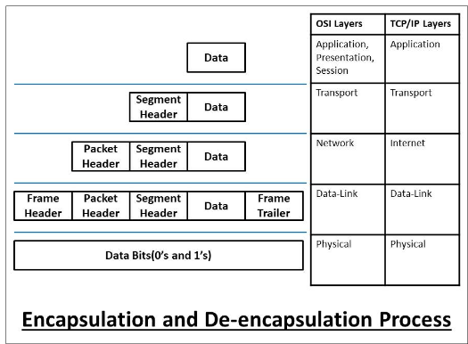

Slide 13
All pictures are from the internet

